Slide 1
Alliance Specialist Operations
Drone Team

Slide 2
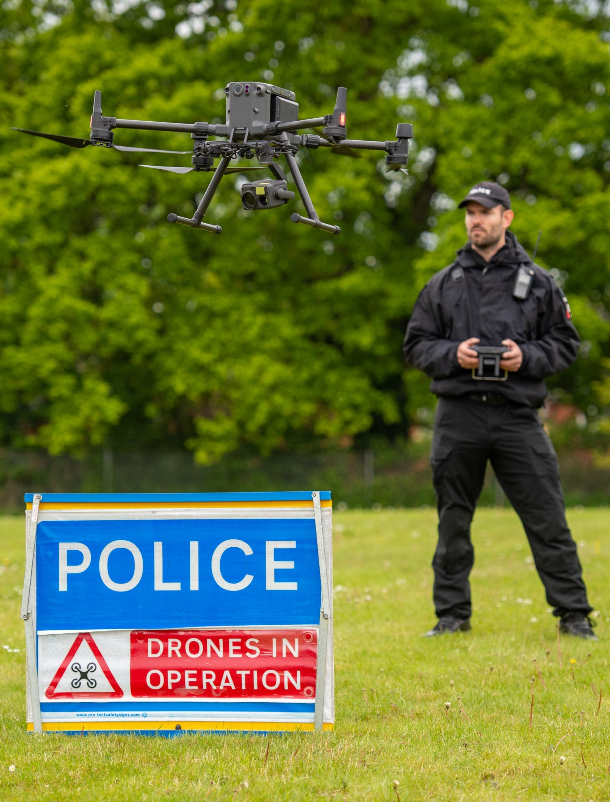
Overview
Why do we utilise drones?
Police drone use, law, and air safety
Current equipment

Slide 3
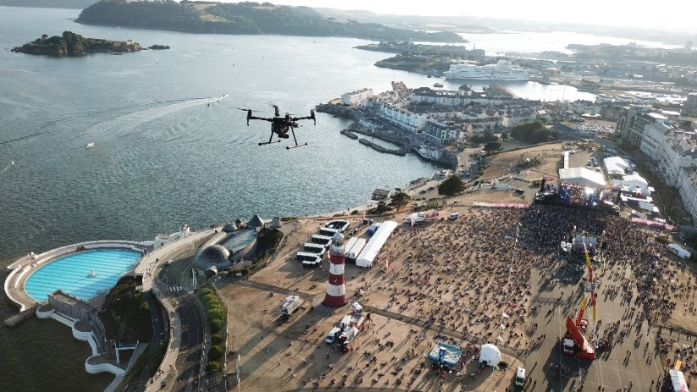
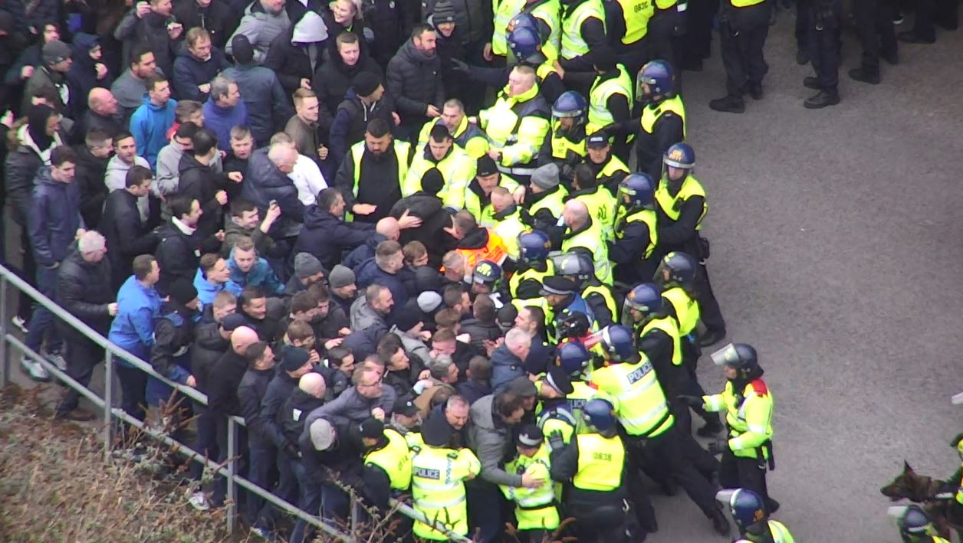
Types of Incidents
Types of Incidents
Missing people searches
Offender searches
Firearms – planned & spontaneous
Evidential/Crime Scenes
Large events (E.g. Boardmasters, Tar Barrels)
VIP Visits
Contingency Planning
Intelligence – Reccies
Thermal - Cannabis grows
Estates department
PR/Corporate Comms
…Anything where an aerial view or increased situational awareness would be beneficial

Slide 4
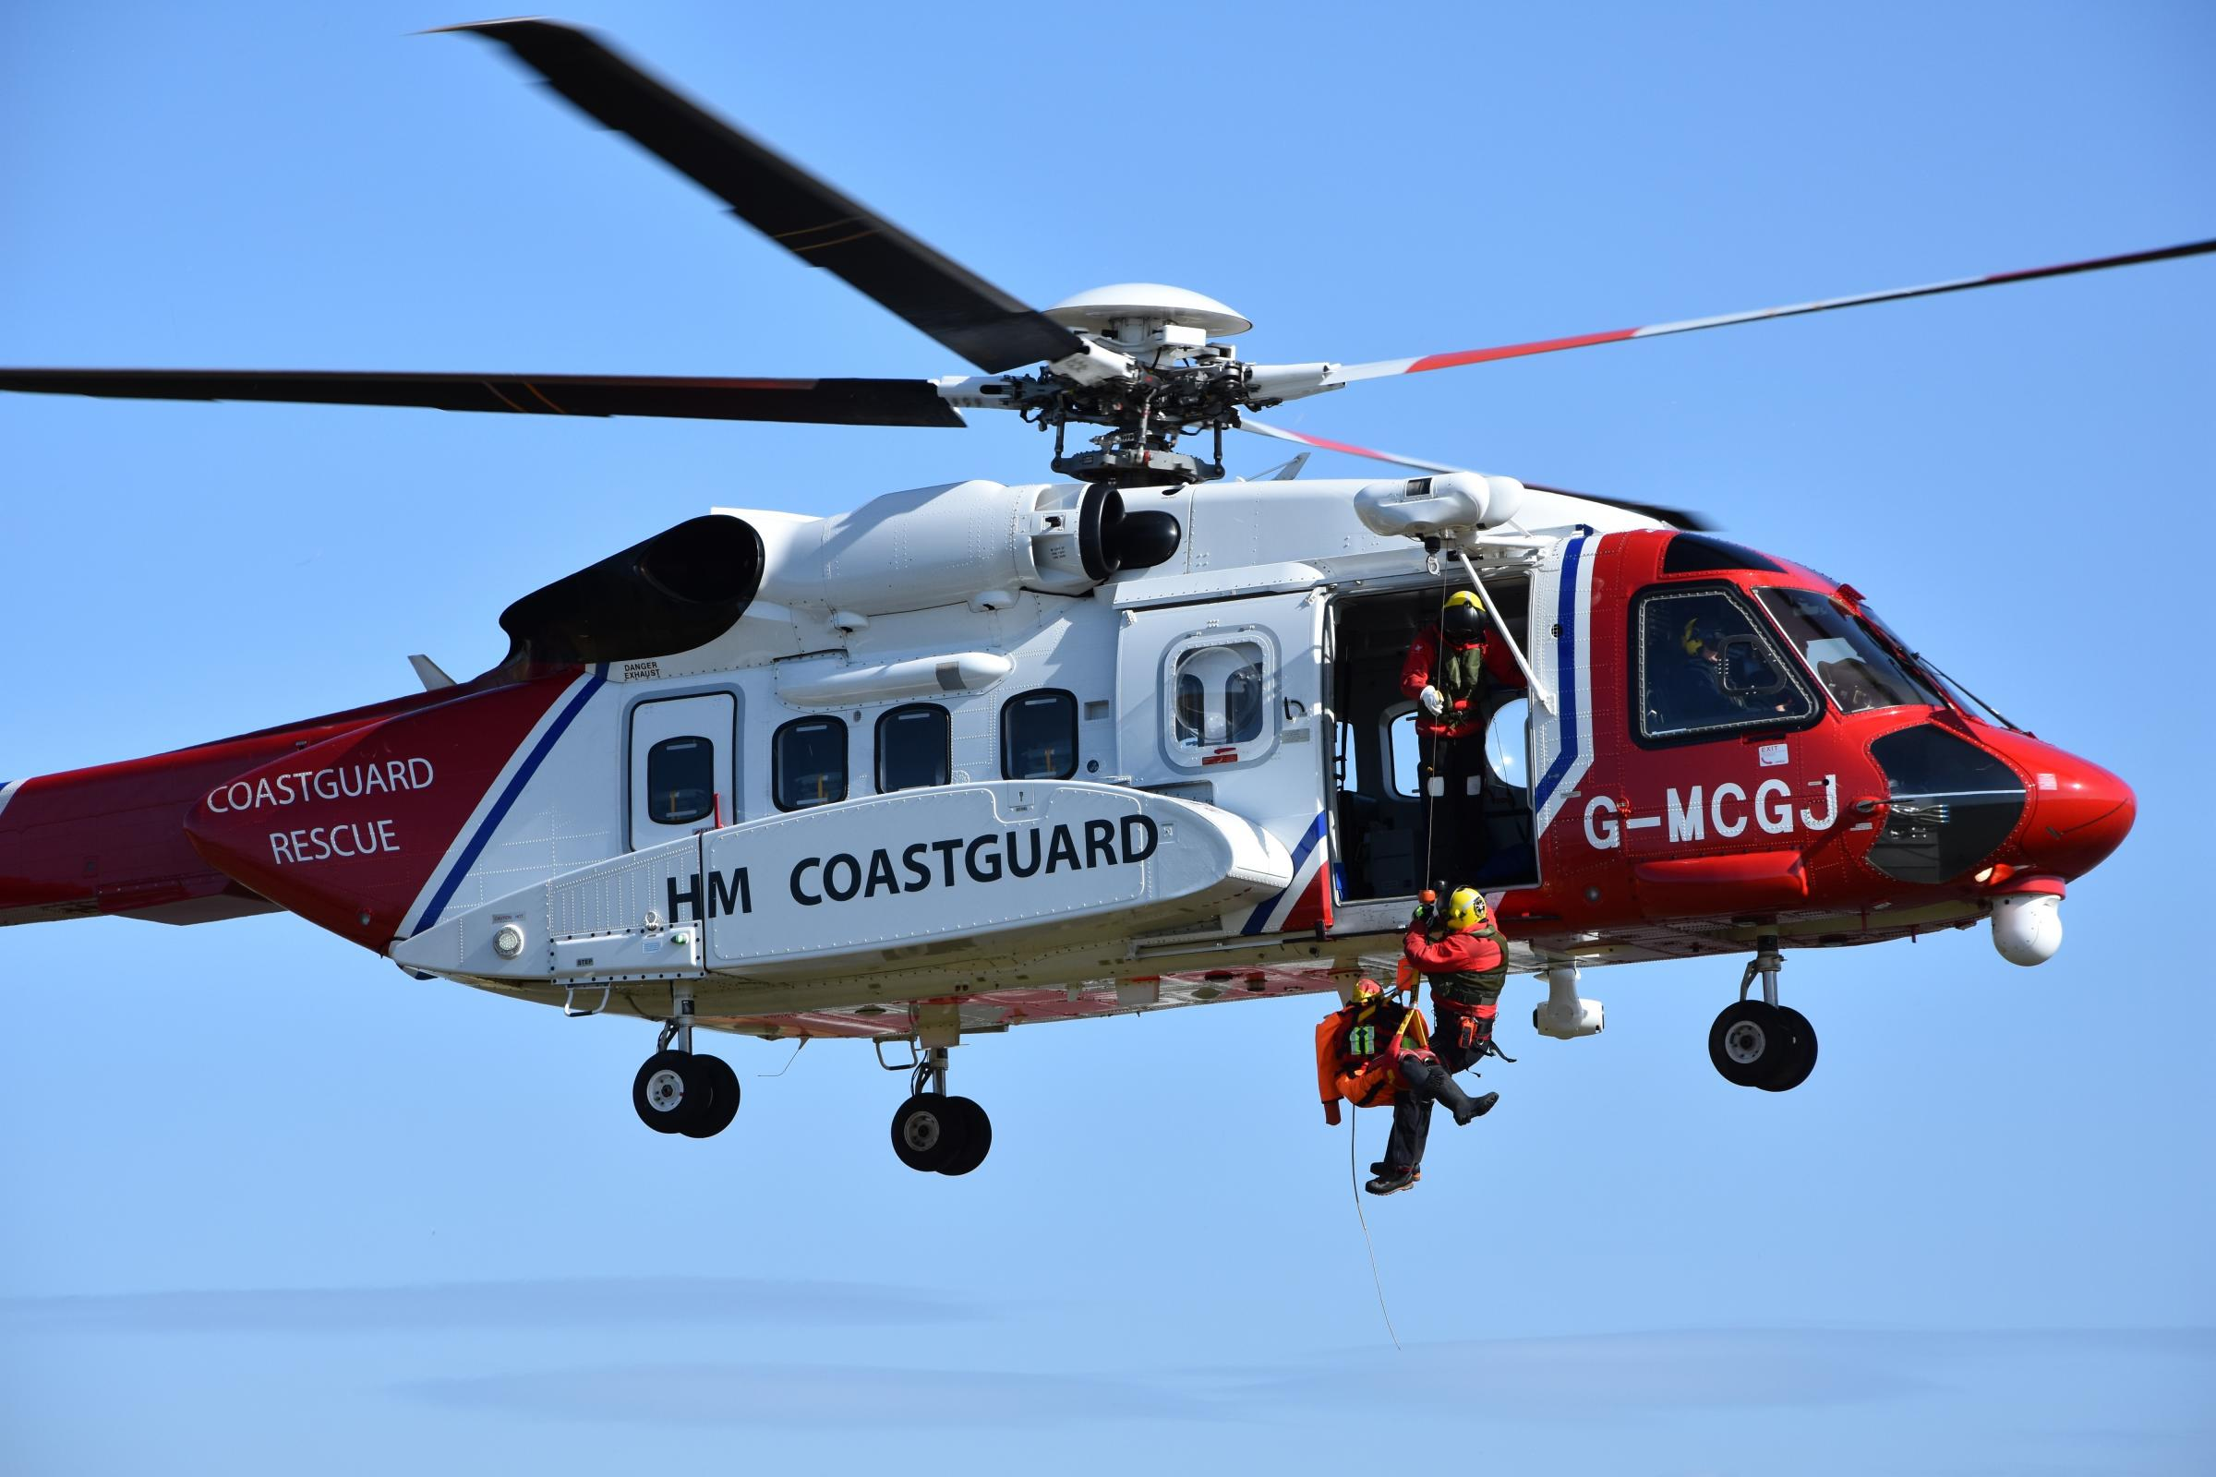
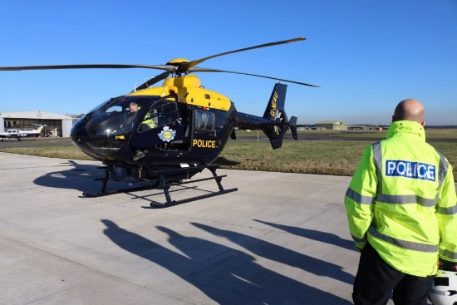
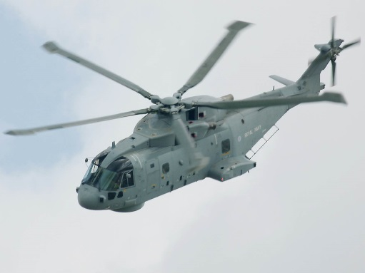
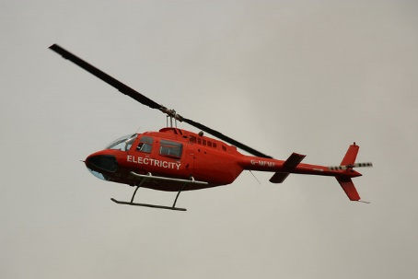
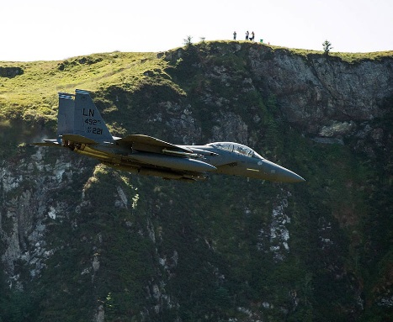
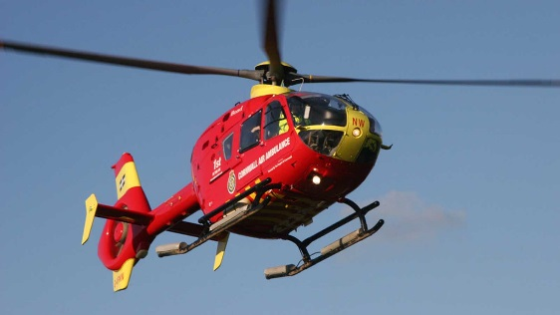
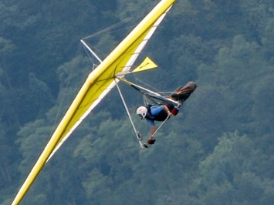
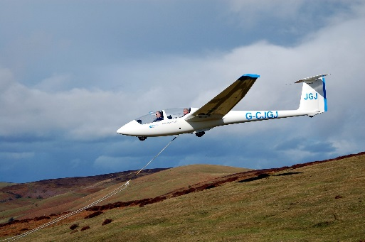
Airspace Below 400ft

Slide 5
Rules
All drone use in the UK is governed by the Civil Aviation Authority and is contained within The Air Navigation Order
3 operating categories: Open (Low risk), Specific (Medium risk) and Certified (High risk – equivalent to manned aviation)
Limitations depend on the weight of the drone, the competency/qualifications of the pilot and the place it is being flown.

Slide 6
Rules
All drones must:
Stay below 400ft (120metres) Above Ground Level (AGL)
Remain within Visual Line Of Sight (VLOS) of pilot, including being able to confirm orientation of drone and never more than 500m away.
Display an Operator ID if drone has a camera or is over 250g (not an obvious toy)
Pilot must hold a Flyer ID if over 250grams
Not fly within 50 metres horizontally of uninvolved people if drone is over 250grams
Never fly over assemblies of people
Cannot endanger people, property or other aircraft

Slide 7
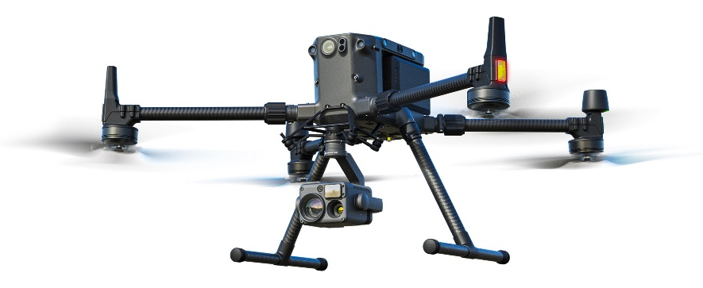
Alliance Drone Team - Additional Permissions
Hold an Operational Authorisation (OA) as well as an Operational Safety Case (OSC)
Fly Extended Visual Line Of Sight (EVLOS) with dedicated observers
500m
500m

Slide 8
Alliance Drone Team - Additional Permissions
Hold an Operational Authorisation (OA) as well as an Operational Safety Case (OSC)
Fly Extended Visual Line Of Sight (EVLOS) with dedicated observers
Fly Beyond Visual Line Of Sight (BVLOS) for Major Incidents or serious threat to life
Fly up to 1000ft (AGL)
Fly with reduced horizontal separation from Uninvolved Persons
500m
500m
500m
1500m

Slide 9
Air Traffic Management & Unmanned Aircraft Act 2021
Power to require an Unmanned Aircraft to be Grounded
Reasonable Grounds for Suspecting aircraft is or has been involved in the commission of ANY offence.
Power to Stop and Search Persons or Vehicles
Reasonable Grounds for Suspecting will find a drone or associated article involved in the commission of following offences:
Flying in Aerodrome FRZ without permission / Flying in restricted airspace
Endangering Aircraft or persons on aircraft
Operator not complying with Implementing Regulations
Flyer not complying with Implementing Regulations
Any relevant Prison offence

Slide 10
Air Traffic Management & Unmanned Aircraft Act 2021
Power of Seizure following Stop and Search
A Constable may seize ANYTHING they find if they have reasonable grounds for believing is evidence of an offence.
Power to enter and search premises under a warrant
A Justice of the Peace may issue a warrant authorising a Constable to enter and search a premises and seize anything they believe is evidence of a relevant UA offence.
Use of Force
Constable may use reasonable force for the purposes of exercising these powers

Slide 11
Equipment
DJI M300
35-40 min minute flight time
Optical zoom, thermal imaging, laser range finder
Can fly in rain
Winds resistance up to 35mph
Can operate in -20 degrees
Additional payloads e.g. spotlight

Slide 12
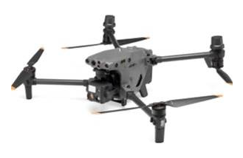
Equipment
DJI M30T
30-35 min minute flight time
Optical zoom, thermal imaging, laser range finder
Can fly in rain
Winds resistance up to 33mph
Can operate in -20 degrees

Slide 13
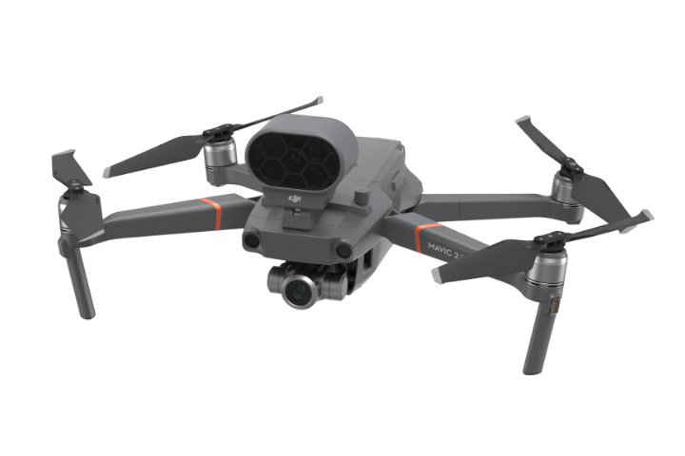
Equipment
DJI Mavic 2 Enterprise
Very small and quick to deploy
Flight time 20-25 minutes
Can’t fly in rain
Wind resistance up to 24mph
No thermal capability
Speaker / spotlight / strobe attachments

Slide 14
For more information please email:
drones@dc.police.uk

